Slide 1




OPERATORS

Slide 2

Compiler Options
You use Option statements to set the "ground rules" for your code, helping prevent syntax and logic errors. Here are the possibilities:
Option Explicit— Set to On or Off. On is the default. Requires declaration of all variables before they are used (this is the default).
Option Compare— Set to Binary or Text. This specifies if strings are compared using binary or text comparison operations.
Option Strict— Set to On or Off. Off is the default. When you assign a value of one type to a variable of another type Visual Basic will consider that an error if this option is on

Slide 3
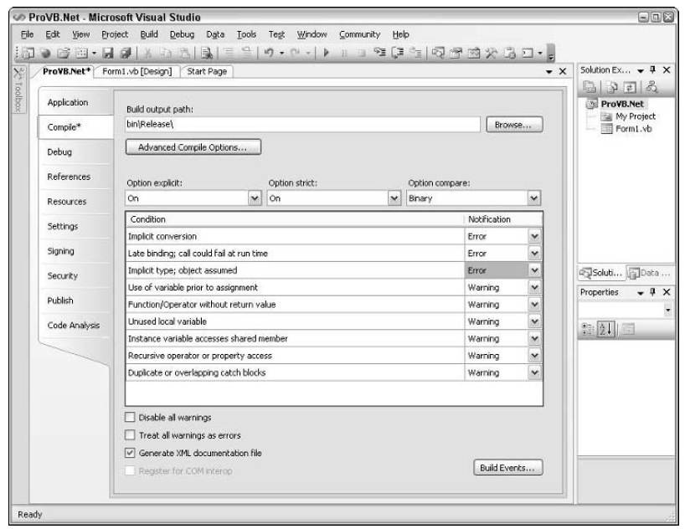
Compiler Options

Slide 4
Char and Byte
With the difference between the Chr and ChrW methods being the range of valid input values that is available. The ChrW method allows for a broader range of values based on wide character input.
Dim chrLtr_a As Char = “a”c
Dim chrAsc_a As Char = Chr(97)
Dim chrAsc_b as Char = ChrW(98)

Slide 5
Char and Byte
In Visual Basic, the Byte value type expects a numeric value. Thus, to assign the letter “a” to a Byte, you
must use the appropriate character code. One option to get the numeric value of a letter is to use the Asc
method, as shown in the following line of code:
Dim bytLtrA as Byte = Asc(“a”)

Slide 6
Structures: Your Own Data Types
You can combine data items of different types to create a structure. A structure associates one or more members with each other and with the structure itself. When you declare a structure, it becomes a composite data type, and you can declare variables of that type.
A structure is a generalization of the user-defined type (UDT) supported by previous versions of Visual Basic. In addition to fields, structures can expose properties, methods, and events. A structure can implement one or more interfaces, and you can declare individual accessibility for each field.

Slide 7
Structures: Your Own Data Types
Private Structure Employee
Public GivenName As String ' This employee's given name.
Public FamilyName As String ' This employee's family name.
Public Extension As Long ' This employee's telephone extension.
Private Salary As Decimal ' This employee's annual salary.
Public Sub GiveRaise(Raise As Double) ' Raise this employee's salary.
Salary *= Raise
End Sub
Public Event ReviewTime() ' This employee must be reviewed.
End Structure

Slide 8
Operators
Operator Types
    Arithmetic : Operators used to perform
mathematical calculations.
    Comparison :Operators used to perform comparisons.
    Logical :Operators used to perform logical operations.

Slide 9
Arithmetic Operators
Symbol
Meaning
Example
Result
+
Addition
10+3
13
-
Substraction
10
-
3
7
*
multiplication
10*3
30

Slide 10
Arithmetic operators cont:-
/
division
10/3
3.33333
\
Integer
10
\
3
3
division
^
Exponention
10^3
1000
Mod
Remainder
10 mod 3
1

Slide 11
    Used to compare two expressions.
    Comparison operators, also known as relational operators, compare two expressions. The following table contains a list of the comparison operators and the conditions that determine whether result is True, False, or Null:
    Syntax
    Result = Expr1 Operator Expr2
Comparison operators

Slide 12
Comparison operators
Operator Meaning
= Equal to returns True if the values on both sides are the same.
<> Not equal, True if the values on the two sides differ.
< Less than , True if the left side less than the right side.
> Greater than; True if the left side is greater than the right side.
<= less than or equal.
>= Greater than or equal.

Slide 13
Logical Operators
The logical operators compare Boolean expressions and return a Boolean result. The And, Or, AndAlso, OrElse, and Xor operators take two operands, and the Not operator takes a single operand.
The Not operator performs logical negation on a Boolean expression. Put simply, it yields the opposite of the expression it evaluates. If the expression evaluates to True, Not yields False; if the expression evaluates to False, Not yields True. An example is shown below:
Dim x As Boolean
x = Not 23 > 12 ' x equals False.

Slide 14
Logical Operators
The And operator performs logical conjunction on two Boolean expressions. That is, if both expressions evaluate to True, then the And operator returns True. If either or both expressions evaluate to False, then And returns False.
The Or operator performs logical disjunction on two Boolean expressions. If either expression evaluates to True, Or returns True. If neither expression evaluates to True, Or returns False.

Slide 15
Logical Operators
Xor performs logical exclusion on two expressions. If either expression evaluates to True, but not both, Xor returns True. If both expressions evaluate to True or both expressions evaluate to False, Xor returns False.
Examples of the And, Or, and Xor operators are shown below:
Dim x As Boolean
x = 23 > 12 Or 4 > 12` ' x = True
x = 23 > 45 Or 4 > 12 ' x = False
x = 23 > 45 Xor 12 > 4 ' x = True
x = 23 > 12 Xor 12 > 4 ' x = False
x = 12 > 23 Xor 4 > 12 ' x = False

Slide 16
Logical Operators
The AndAlso operator is very similar to the And operator, in that it also performs logical conjunction on two Boolean expressions. The key difference between AndAlso and And is that AndAlso exhibits short-circuiting behavior. If the first expression in an AndAlso expression evaluates to False, then the second expression is not evaluated and False is returned for the AndAlso expression.
Similarly, the OrElse operator performs short-circuiting logical disjunction on two Boolean expressions. If the first expression in an OrElse expression evaluates to True, then the second expression is not evaluated.

Slide 17
Bitwise Operations
Bitwise operations evaluating two values in binary (base 2) form, compare the bits at corresponding positions, and then assign values based on the comparison, as in the demonstration below of bitwise And:
Dim x As Integer x = 3 And 5 ' x = 1 In this example, the value of x is 1. Here's why:
First, the values are converted to binary form, as shown below:
3 in binary form = 011
5 in binary form = 101

Slide 18
Bitwise Operations
011 3 in binary form
101 5 in binary form
001 The result, in binary form
Converting back to decimal, 001 is the binary representation of 1, so x = 1.
The bitwise Or operation is similar, except that a 1 is assigned to the result bit if either of the compared bits is 1. Xor assigns a 1 to the result bit if only one of, but not both of, the compared bits is 1. Not takes a single operand and inverts all the bits, including the sign bit, and assigns that value to the result. This means that for positive numbers, Not always returns a negative.

Slide 19
Bit Shift Operations
A bit shift operation performs an arithmetic shift on a bit pattern. The pattern is contained in the operand on the left, while the operand on the right specifies the number of positions to shift the pattern. The data type of the pattern operand must be Byte, Short, Integer, or Long. The data type of the shift amount operand must be Integer or must widen to Integer.

Slide 20
Bit Shift Operations
In the following example, an Integer value is shifted both left and right:
Dim Pattern As Integer = 12 ' Low-order bits are 0000 1100
Dim LResult, RResult As Integer
LResult = Pattern << 3 ' Left shift of 3 bits produces value of 96
RResult = Pattern >> 2 ' Right shift of 2 bits produces value of 3 Arithmetic shifts.

